Slide 1
Functions, notation and logarithms: why AI adds log-probabilities
A language model gives every possible next word a probability. Why does training work with the logarithm of that probability?
Mathematics for AI and Machine Learning | Session 1 of 18 | Foundations
KLAi Professional Learning | Jotham Martin Wambi
Notes:
Welcome to Mathematics for AI and Machine Learning. I am Jotham, and I will teach you the mathematics under modern AI, with a picture first, then a calculation by hand, then the same idea on a computer, and then where it appears in real AI tools. Today is the first step.
We learn the notation, and we meet the logarithm. By the end you will understand why training a language model uses the logarithm of a probability.

Slide 2



Today in one view: what you will leave with
By the end of today you can
Read sigma notation and function notation, and evaluate both by hand
Use exponentials and logarithms, and the three log rules, to turn a product into a sum
Compute the log-probability of a word and of a sentence in Python and in a spreadsheet
Notes:
Here is what you can do by the end of today. You can read sigma notation and function notation and work them out by hand. You can use exponentials and logarithms, with the three log rules, to turn a product into a sum. And you can compute the log-probability of a word and of a whole sentence, in Python or in a spreadsheet, with the same answers in both.
We build up to one real question from AI, and you will be able to answer it before we leave.

Slide 3
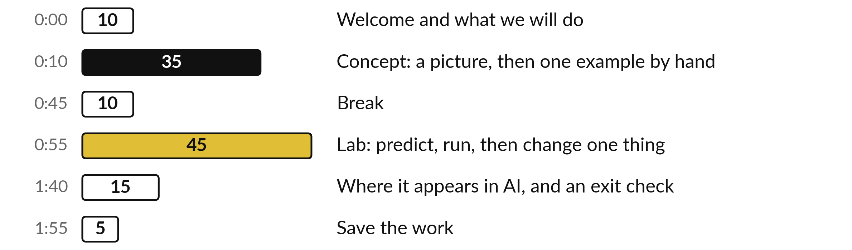
Your two hours: sums, functions
and logarithms, then the lab, then AI
Ideas first. Then the lab, in Python or in a spreadsheet. Then where it shows up in AI.
Notes:
We have two hours. The first ten minutes are this welcome. Then thirty-five minutes of ideas with pictures, a break, and a forty-five minute lab where you work in Python or in a spreadsheet on the same numbers. The last twenty minutes show where today appears in AI tools, with an exit check, and then you save your work.
The lab is where the learning sticks, so please protect that time.

Slide 4


Words we use today
Word | What it means
Sigma notation | The symbol Σ means add up. Sigma notation is a short way to write a long sum.
Function | A rule that turns each input number into one output number, written f(x).
Exponential function | A function where the input is a power, such as 2ˣ (2 to the power x). It grows by repeated multiplying.
Logarithm (ln) | The inverse of an exponential. The natural logarithm ln uses the base e = 2.71828.
Log-probability | The natural logarithm of a probability. It is zero or negative, because a probability is at most 1.
Notes:
Five words for today. I give the plain meaning of each, and we use every one of them before the end of the session.
Sigma notation. The symbol Σ means add up. Sigma notation is a short way to write a long sum.
Function. A rule that turns each input number into one output number, written f(x).
Exponential function. A function where the input is a power, such as 2ˣ (2 to the power x). It grows by repeated multiplying.
Logarithm (ln). The inverse of an exponential. The natural logarithm ln uses the base e = 2.71828.
Log-probability. The natural logarithm of a probability. It is zero or negative, because a probability is at most 1.

Slide 5
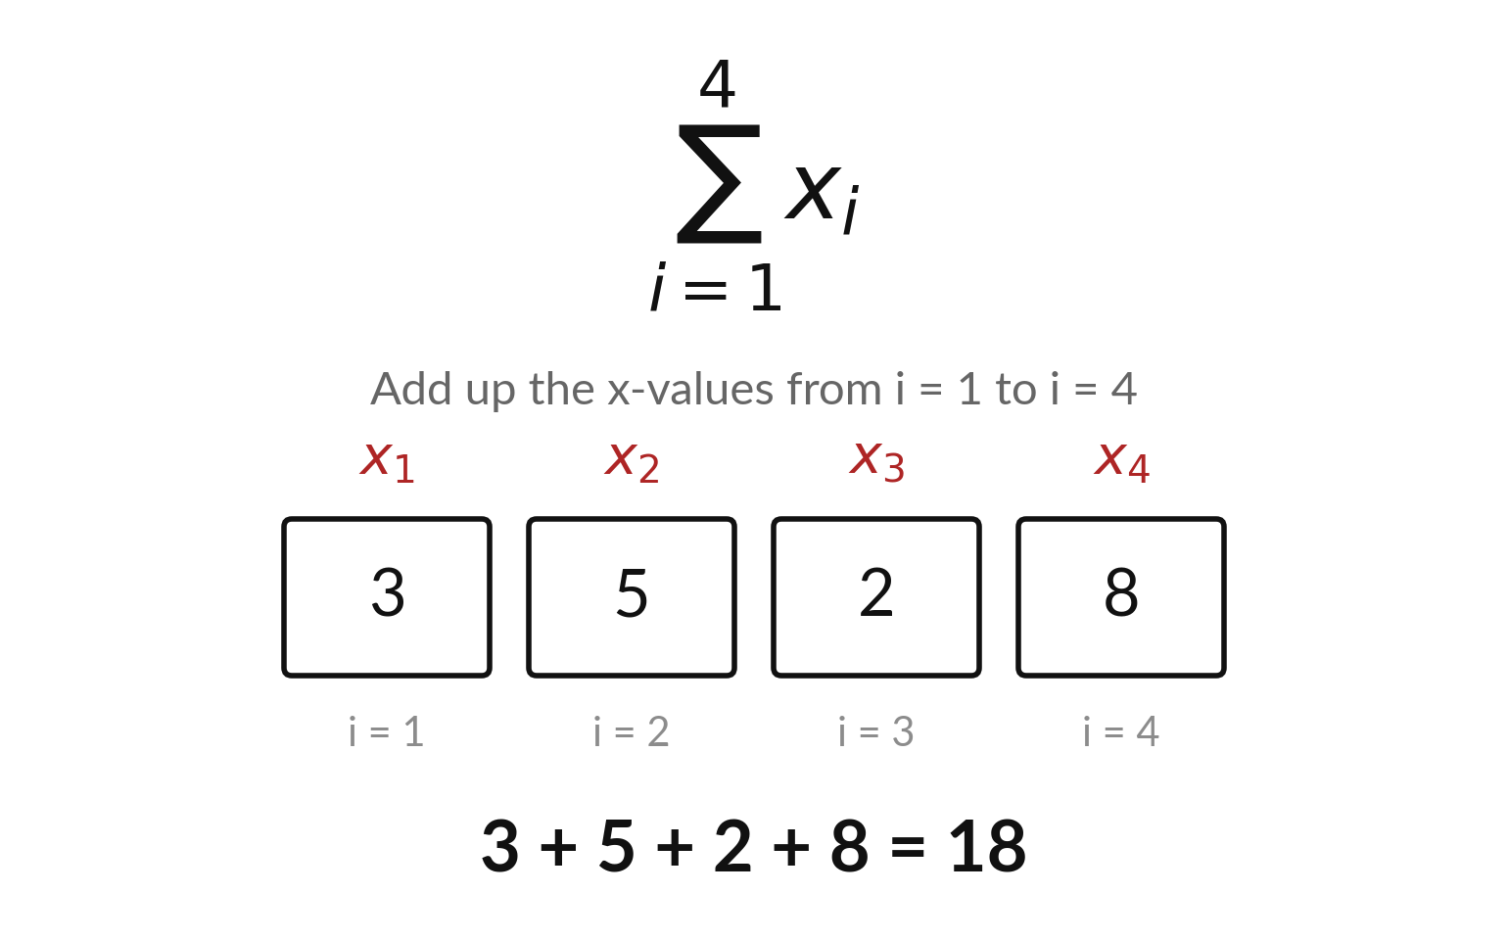
The sigma symbol is a short
way to write a long sum
Sigma notation: the capital Greek letter Σ means add up.
Below Σ, i = 1 is where to start. Above Σ, the 4 is where to stop.
Each box is one value, x with its index i.
The values 3, 5, 2 and 8 add up to 18.
Notes:
This is sigma notation. The big symbol is the Greek capital letter sigma, and it simply means add up. Underneath it, i equals one tells you where to start counting. On top, the four tells you where to stop. Then x with a little i is the value at position i.
So this expression says add the first, second, third and fourth values. Here that is three plus five plus two plus eight, which is eighteen. The small letter i is called the index, and it just counts the position in the list. Can you write the sum of the first three values?

Slide 6
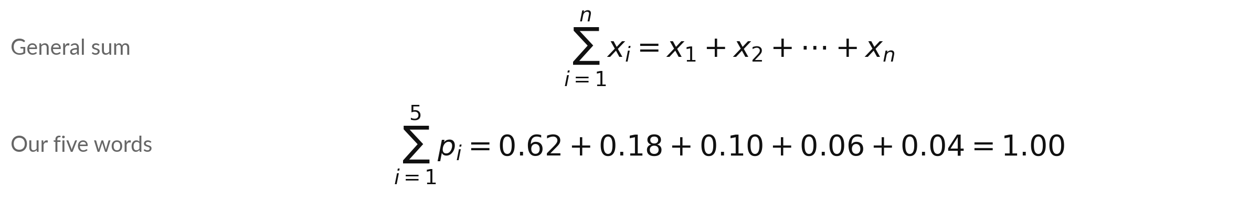
Sigma notation in action: the five
next-word probabilities add up to 1
Symbol | What it means | In our data
Σ (sigma) | Add up everything after it. | a sum of five numbers
i | The index: the position in the list (1, 2, 3 ...). | i = 1 to 5
n | How many values there are. | n = 5 words
pᵢ | The probability of word i after "The capital of Uganda is". | p₁ = 0.62 for Kampala
Illustrative (made-up numbers): Kampala 0.62, Entebbe 0.18, a 0.10, the 0.06, Nairobi 0.04.
Notes:
Now the same idea with numbers we will use all day. Imagine a model that has to guess the next word after the capital of Uganda is. It gives five candidate words a probability each. A probability is a number from zero to one, where one means certain.
These numbers are made up to show the arithmetic. The sigma sum adds them: zero point six two, plus zero point one eight, plus zero point one, plus zero point zero six, plus zero point zero four. The total is exactly one, because the model must choose something.
What would it mean if the total were two?

Slide 7
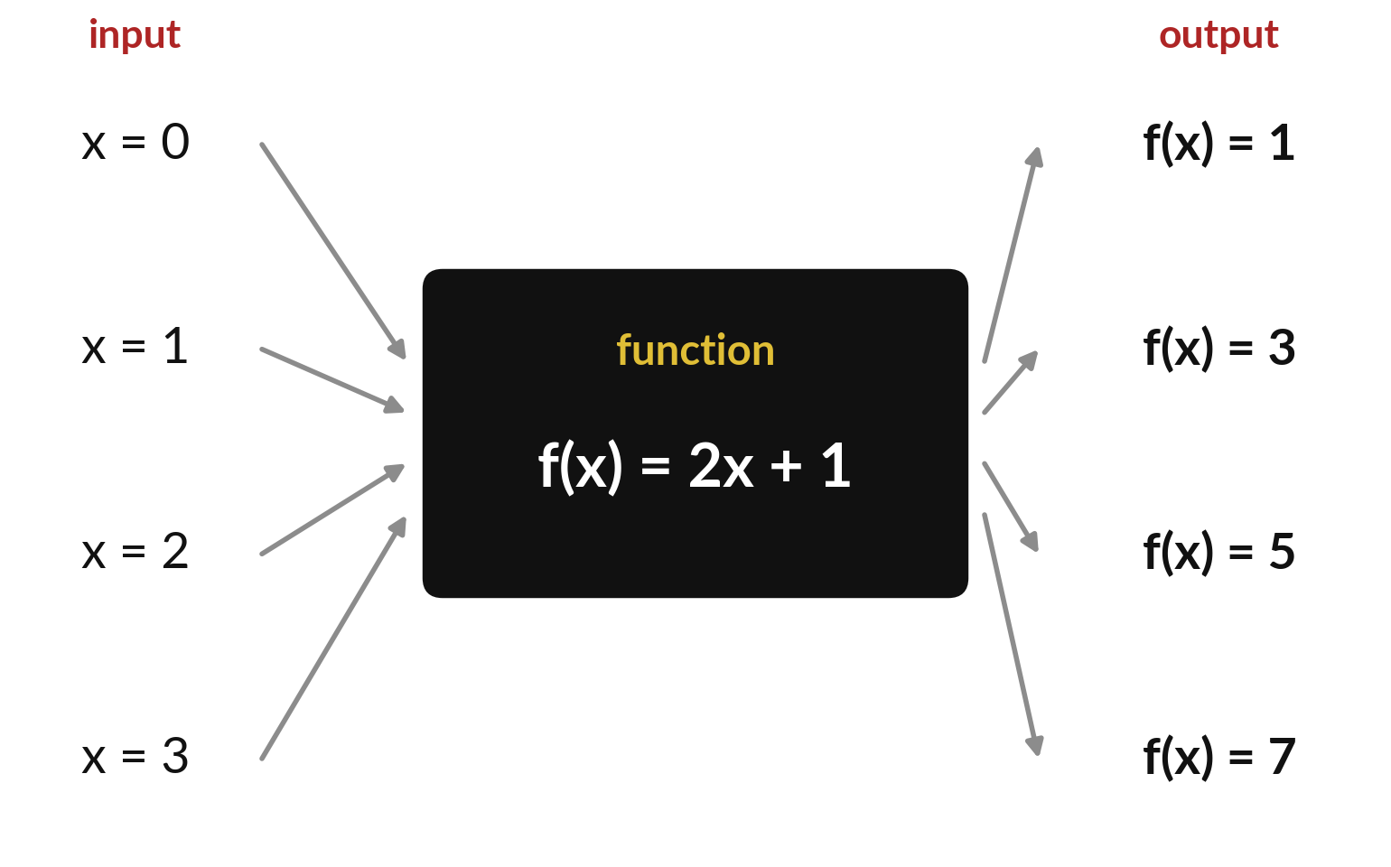
A function turns each input number
into exactly one output number
A function is a rule. Give it an input x and it returns one output, written f(x).
Here the rule is f(x) = 2x + 1: double the input, then add 1.
Put in x = 3. Double it to get 6, add 1, and f(3) = 7.
The same input always gives the same output.
Notes:
A function is a rule with one job. You give it an input, called x, and it gives back exactly one output, which we write f of x. In this picture the rule is two x plus one. So double the input and add one. If x is three, double it to get six, add one, and f of three is seven.
The machine in the middle is just the rule. And the key property is that the same input always gives the same output. What does f of ten give?

Slide 8
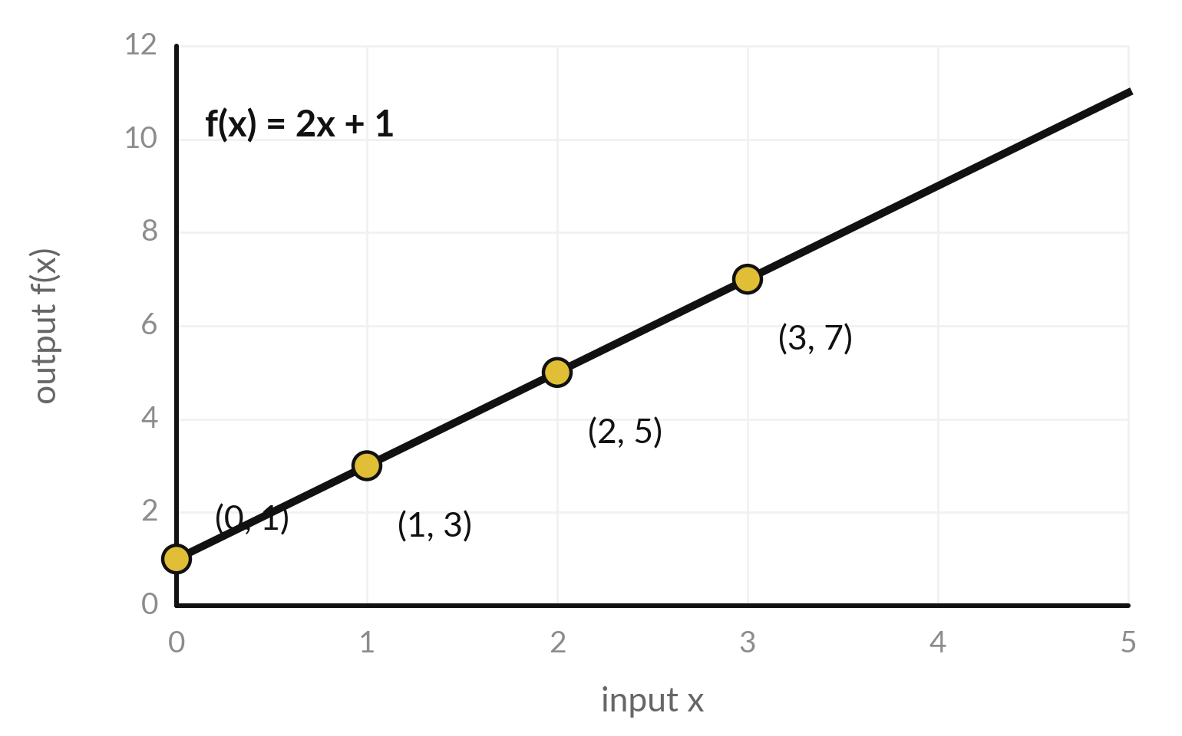
A graph draws every input
and its output as a point
A graph plots each pair (x, f(x)) as a point. Joining the points draws the curve.
Across: the inputs x. Up: the outputs f(x).
Each gold dot is one pair, such as x = 3 and f(3) = 7.
Each step of 1 in x adds 2: a straight line.
Notes:
A graph is a picture of a function. The horizontal axis holds the inputs and the vertical axis holds the outputs. Each gold dot is one pair, an input and the output the rule gave. At x equals three the output is seven, so there is a dot at three across and seven up.
Join all the dots and you get the curve of the function. For this rule the curve is a straight line, because every step of one in x adds two to the output. That number two is the slope. What would the slope be if the rule were three x plus one?

Slide 9
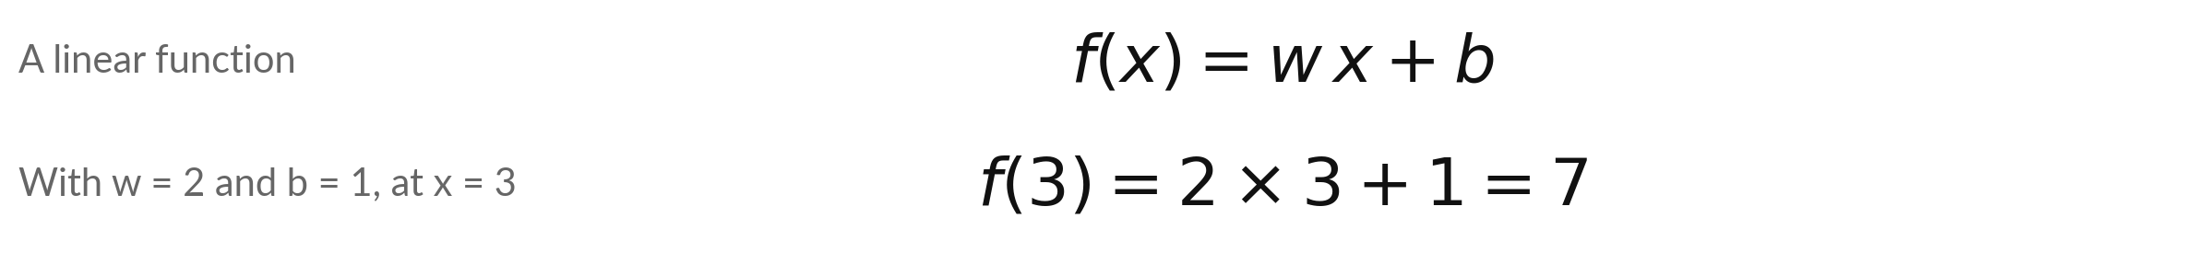
The function f(x) = wx + b is the
building block of machine learning
Symbol | What it means | In our data
x | The input. | x = 3
f(x) | The output for the input x. | f(3) = 7
w | The weight: how much the output grows when x grows by 1. It is also called the slope. | w = 2
b | The bias (intercept): the output when the input is 0. | b = 1
w and b are parameters: numbers a model learns. Session 3 writes y = Wx + b for many inputs.
Notes:
Here is the same function written with letters, because this exact shape is the building block of machine learning. F of x equals w times x plus b. The letter w is the weight, how much the output grows for each extra unit of input. The letter b is the bias, also called the intercept, which is the output when the input is zero.
With w equal to two and b equal to one, and x equal to three, we get seven again. In machine learning, w and b are the parameters, the numbers a model learns from data. Which one of the two decides how steep the line is?

Slide 10
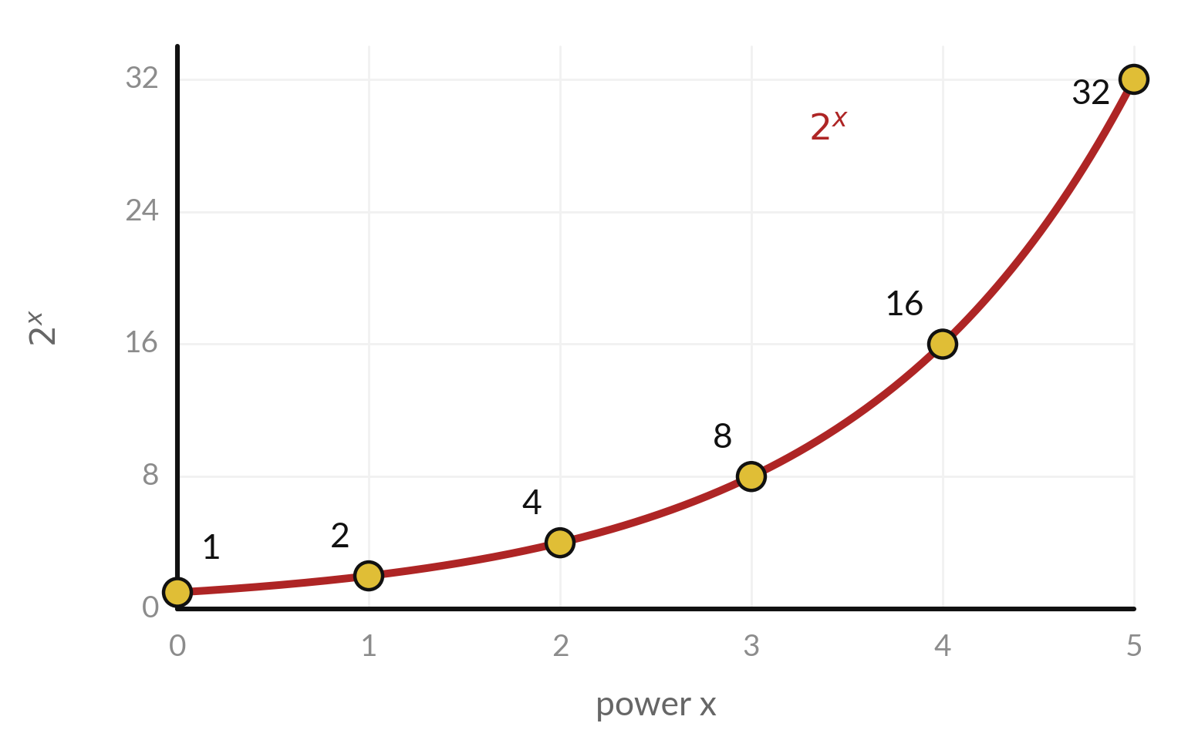
An exponential function multiplies
again and again, so it grows very fast
Exponential function: the input is the power. 2ˣ means x copies of 2 multiplied together: 2³ = 2 × 2 × 2 = 8.
2¹ = 2, 2² = 4, 2³ = 8, 2⁴ = 16, 2⁵ = 32. Each step to the right doubles the height.
The special base e = 2.71828 gives eˣ. It is EXP(x) in a spreadsheet and np.exp(x) in Python.
Notes:
An exponential function has the input up in the power. Two to the power x means x copies of two multiplied together, so two to the power three is two times two times two, which is eight. The values for one to five are two, four, eight, sixteen, thirty-two.
Each step to the right doubles the height, and that is why the curve takes off. There is one special base in mathematics and machine learning, and it is e, about two point seven one eight. It gives e to the x. In a spreadsheet you write EXP, and in Python you write np dot exp.
What is two to the power ten?

Slide 11
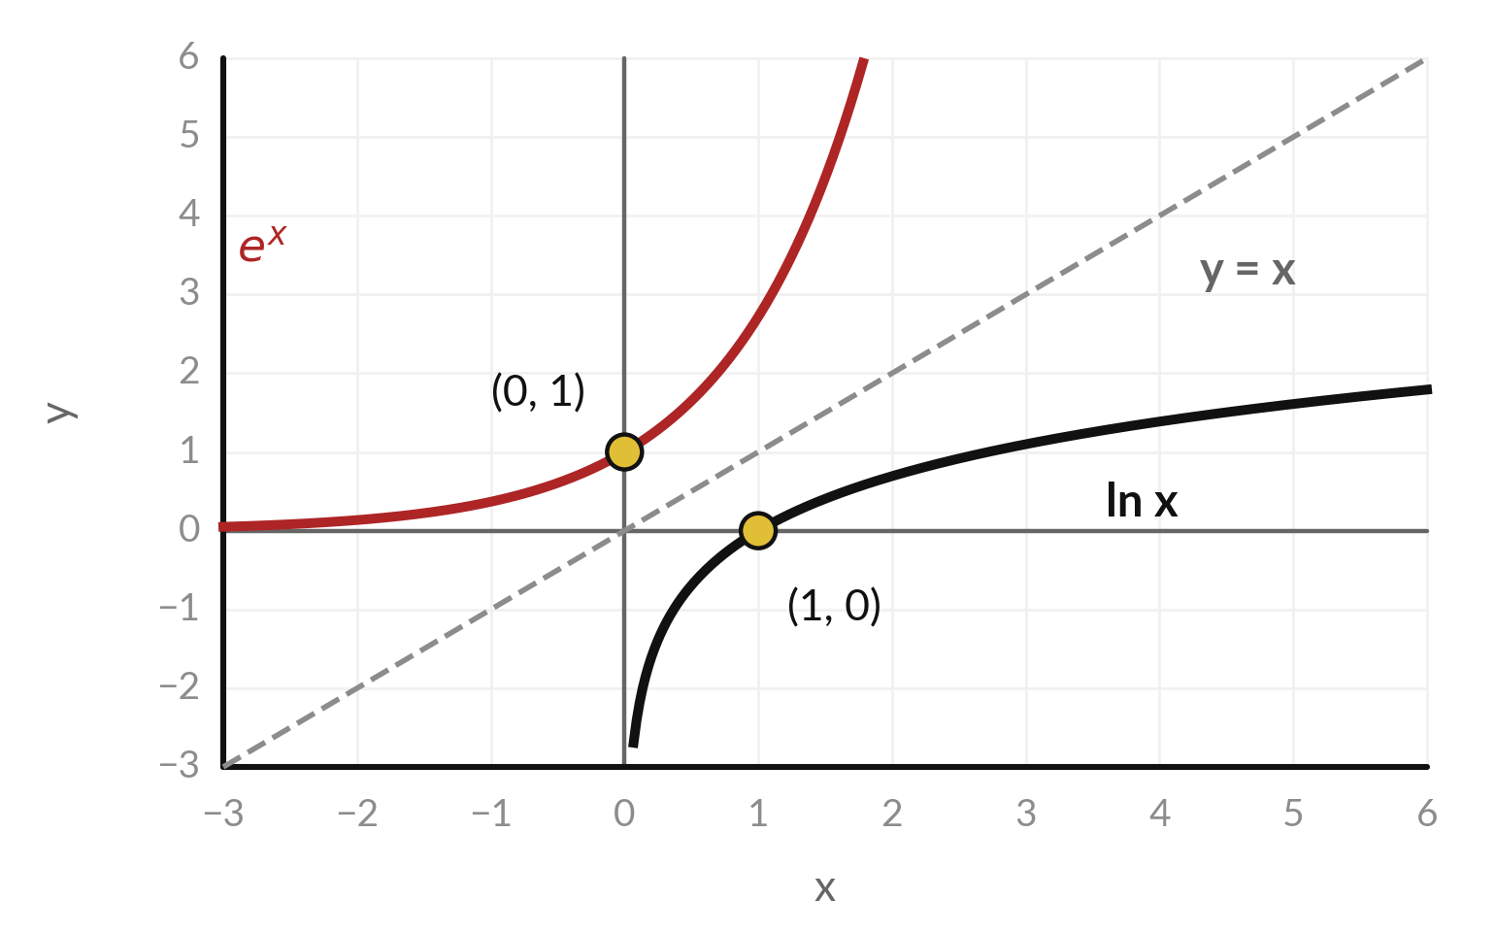
A logarithm undoes an exponential: it
answers "which power gives this number?"
The logarithm is the inverse of the exponential. If 2³ = 8, then log base 2 of 8 is 3.
The curves eˣ and ln x are mirror images across the dashed line y = x.
ln x is the natural logarithm: the logarithm with base e.
ln 1 = 0, because e⁰ = 1. And ln x exists only for x above 0.
Notes:
A logarithm answers one question: which power gives this number?
Two to the power three is eight, so the logarithm base two of eight is three. In machine learning we almost always use the natural logarithm, written ln, which has base e. Look at the picture. The red curve is e to the x, and the black curve is ln of x.
They are mirror images across the dashed line, which is what inverse means. Notice that ln of one is zero, and that ln only exists for numbers above zero. What do you think happens to ln x as x gets closer and closer to zero?

Slide 12
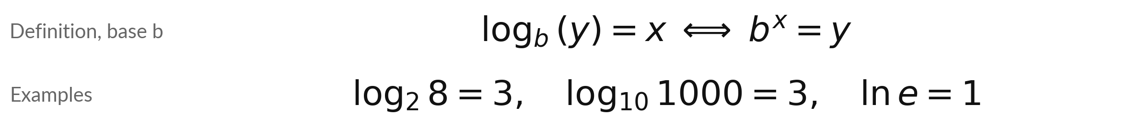
The logarithm as a formula: the
answer x is the power that gives y
Symbol | What it means | In our data
b | The base: the number that is multiplied by itself. Common bases are 2, 10 and e = 2.71828. | b = 2 in log₂ 8 = 3
ln | The natural logarithm: the logarithm with base e. | ln 6 = 1.7918
y | The number we take the logarithm of. It must be above 0. | y = 8 in log₂ 8 = 3
x | The answer: the power that b must be raised to, to give y. | x = 3 in log₂ 8 = 3
Python: np.log is natural, np.log10 is base 10. Spreadsheet: LN is natural, LOG10 is base 10.
Notes:
Here is the definition as a formula. The logarithm base b of y equals x exactly when b to the power x equals y. So log base two of eight is three, log base ten of a thousand is three, and ln of e is one. The base b is the number being multiplied.
The number y must be above zero. And the answer x is the power. Watch the names in the tools. In Python, np dot log is the natural logarithm, and the base ten one is np dot log ten. In a spreadsheet, LN is natural. Which function would you use to get log base ten in Python?

Slide 13
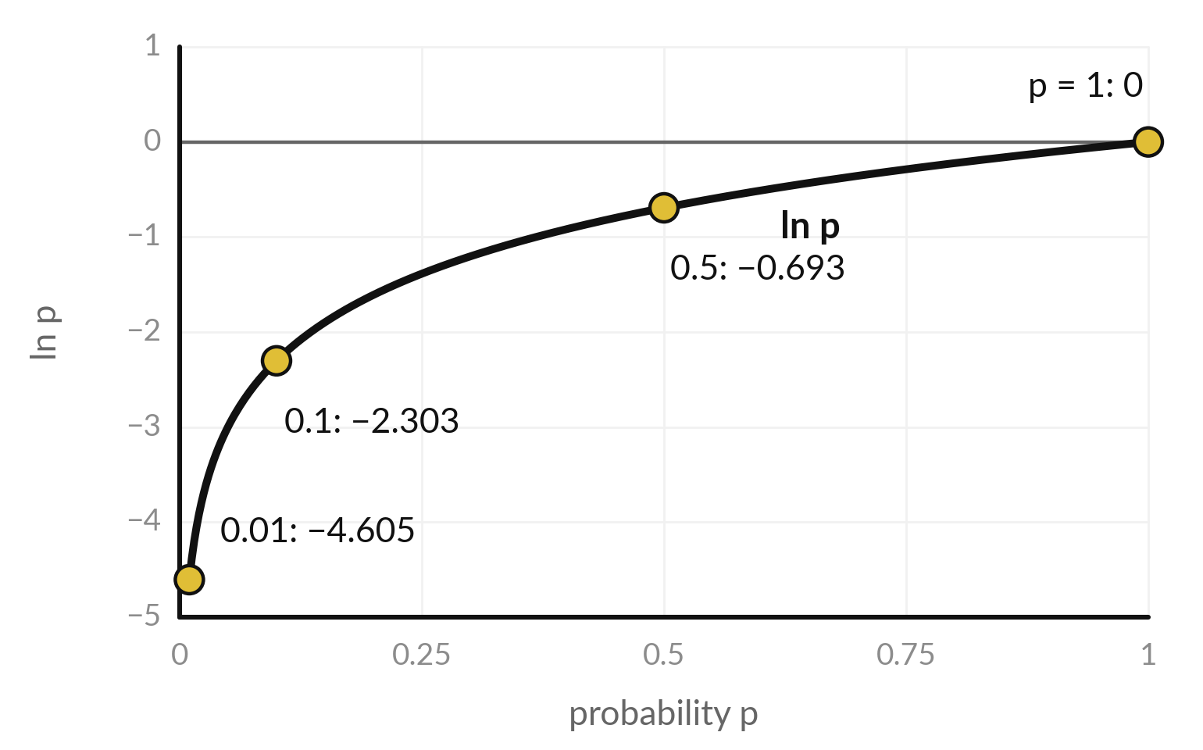
A probability lies between 0 and 1, so
its natural logarithm is zero or negative
A certain event (p = 1) has ln p = 0. The smaller the probability, the more negative ln p.
p = 1 gives 0. p = 0.5 gives −0.693.
Minus ln p is the negative log-probability. It grows as p shrinks.
Training uses it for the correct word as the loss.
Notes:
Now we connect logarithms to probabilities. A probability is between zero and one. Look at the curve of ln p on that range. At p equals one, the logarithm is zero. At one half it is minus zero point six nine three. At one tenth it is minus two point three, and at one in a hundred it is minus four point six.
The smaller the probability, the more negative the logarithm. If we flip the sign we get minus ln p, the negative log-probability, which is positive and grows as the event gets less likely. This is the number that training will use. What is ln of a probability of zero?

Slide 14
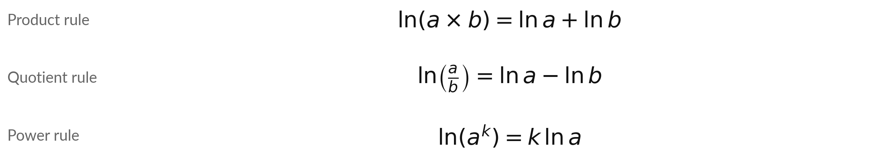
Log rules: a logarithm turns
multiplying into adding
Symbol | What it means | In our data
a and b | Any two numbers above 0. | a = 2, b = 3
k | Any number, used as a power. | k = 2
Worked example | ln 6 = ln 2 + ln 3 | 1.7918 = 0.6931 + 1.0986
Check the quotient rule: ln(6 ÷ 2) = ln 3 = 1.0986, and ln 6 − ln 2 = 1.7918 − 0.6931 = 1.0986.
Notes:
Here are the three log rules. The product rule says the log of a times b is the log of a plus the log of b. The quotient rule says the log of a divided by b is the log of a minus the log of b. And the power rule says the log of a to the power k is k times the log of a.
All three rules say the same thing in different ways: a logarithm turns multiplying into adding. Look at the worked example. The natural log of six is one point seven nine one eight, and the natural logs of two and three are zero point six nine three one and one point zero nine eight six.
They add up. What would the log of a hundred be, if you know the log of ten?

Slide 15
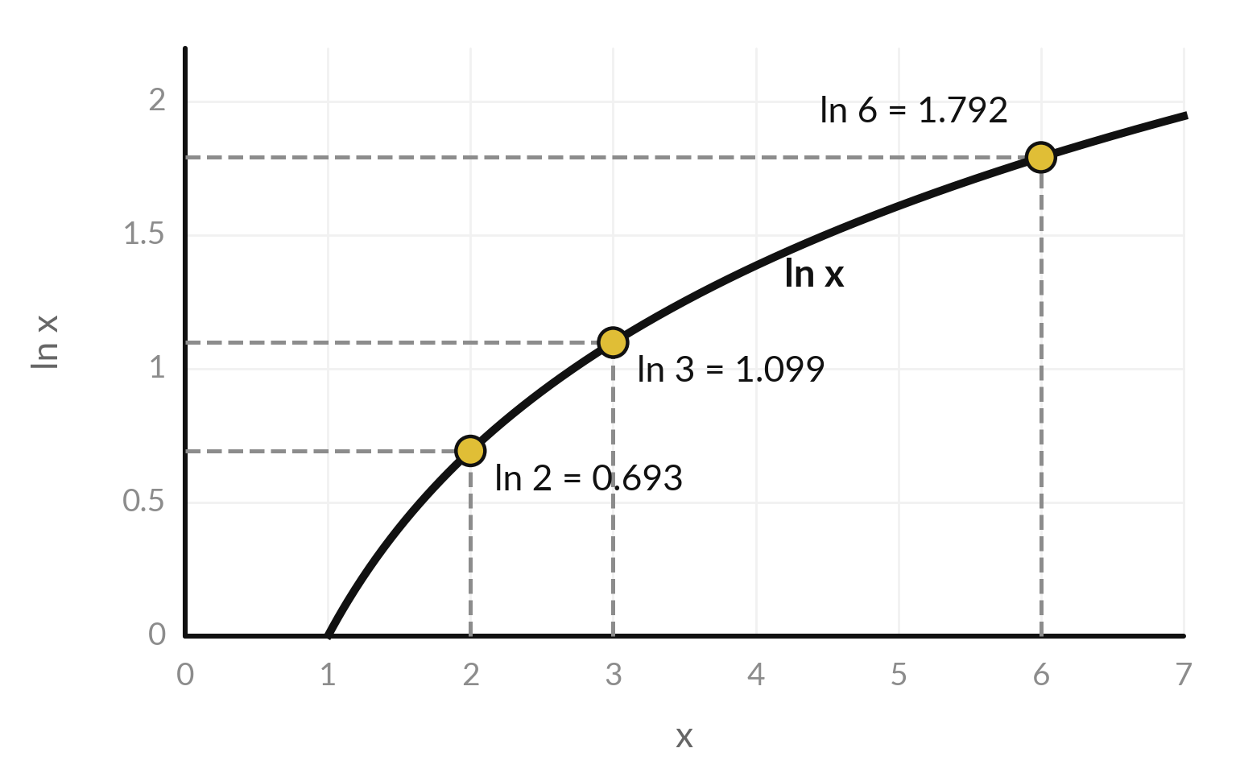
Check the product rule on the
curve: ln 2 plus ln 3 equals ln 6
Product rule check with a = 2 and b = 3: ln 2 + ln 3 should equal ln 6.
ln 2 = 0.6931 and ln 3 = 1.0986. Their sum is 1.7918.
The height of the curve at x = 6 is also 1.7918, because 2 × 3 = 6.
Heights on the curve add when the inputs multiply.
Notes:
Let us check the product rule by hand. Read the heights from the curve. The natural log of two is zero point six nine three one. The natural log of three is one point zero nine eight six. Add them and you get one point seven nine one eight.
Now read the height of the curve at six, and it is one point seven nine one eight too. That is no accident, because two times three is six. The rule says heights on the curve add when the inputs multiply. This picture is the whole reason logarithms matter in AI.
Can you see why that helps when we have to multiply a lot of probabilities?

Slide 16
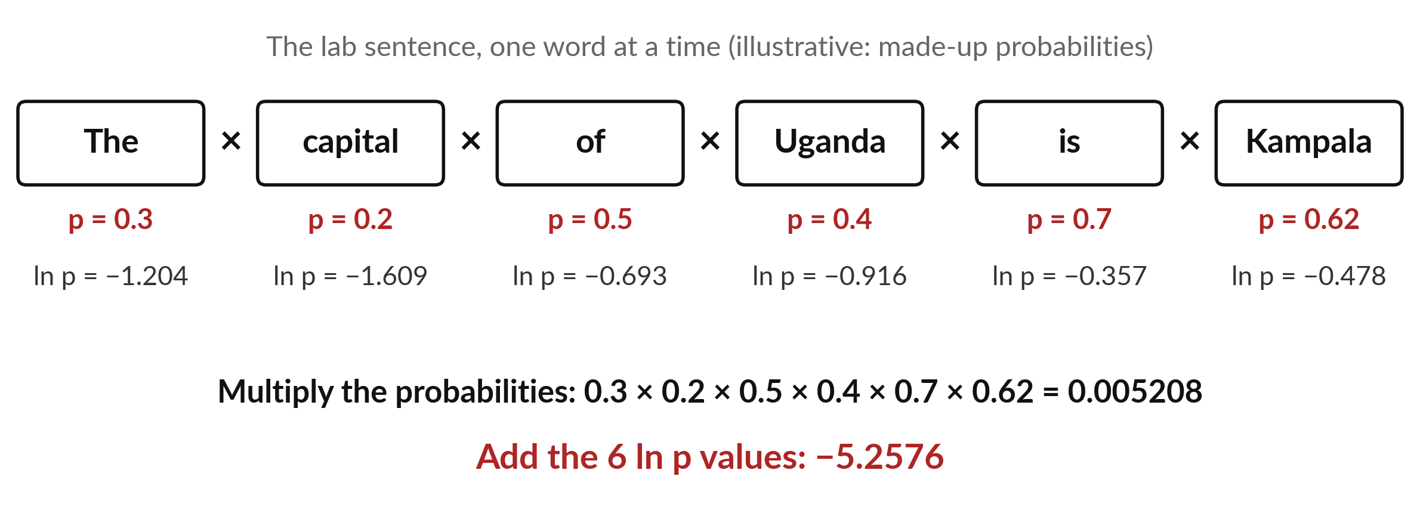
A sentence has the probability of
all its words multiplied together
Multiply the six word probabilities for the sentence. Add their logarithms for its log-probability.
Notes:
Here is the sentence you will use in the lab, six words, with made-up probabilities. Each word has a probability that the model gave it, knowing the words before it. The sentence probability is all six multiplied: zero point three, times zero point two, times zero point five, times zero point four, times zero point seven, times zero point six two.
That is zero point zero zero five two zero eight. Now take the natural log of each word probability and add the six numbers. We get minus five point two five seven six, and the natural log of the product is the same number. Same answer, and now only additions.
Which would you rather do for a thousand words?

Slide 17
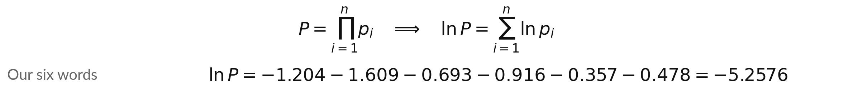
The log of a product is the sum of
the logs: ln P is the sum of the ln pᵢ
Symbol | What it means | In our data
Π (capital pi) | Multiply everything that comes after it. It is the product symbol. | six probabilities
pᵢ | The probability the model gave to word i, knowing the words before it. | 0.3, 0.2, 0.5, 0.4, 0.7, 0.62
P | The probability of the whole sentence. | 0.005208
ln P | The log-probability of the sentence: zero or negative. | −5.2576
Average of minus ln p per word: 5.2576 ÷ 6 = 0.8763. Each ln value above is rounded.
Notes:
Now the formula. A capital pi means multiply, the way a capital sigma means add. So P equals the product of all the word probabilities, p one times p two, and so on up to p n. The product rule, used again and again, says the log of P is the sum of the logs of the p values.
The right side has only additions. For our six words, the product is zero point zero zero five two zero eight, and the sum of the logs is minus five point two five seven six. Divide by six and you get the average per word, zero point eight seven six three.
This identity is the bridge from probabilities to the training of language models. Why is it good that the right side has only additions?

Slide 18
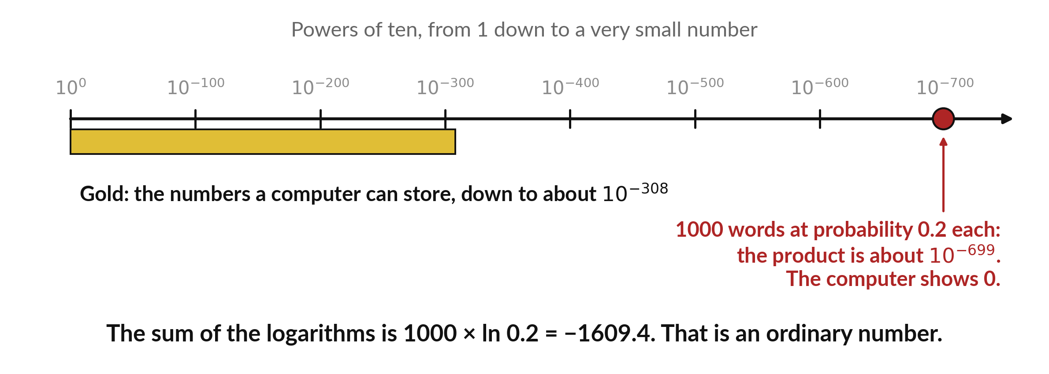
A long product of probabilities shrinks to zero,
but the sum of the logarithms stays usable
A computer stores numbers down to about 10⁻³⁰⁸. Below that, a product rounds to 0 (underflow).
Notes:
Here is the practical reason. A computer stores numbers only down to about ten to the minus three hundred and eight. Below that it rounds to zero, which is called underflow. Take a text of one thousand words, where each word has probability zero point two. The product is about ten to the minus six hundred and ninety-nine, far below the limit, so the computer shows zero.
But the sum of the logarithms is one thousand times minus one point six one, which is minus one thousand six hundred and nine, an ordinary number. Real texts are long, so AI software always works with log-probabilities. Does that make sense?

Slide 19
Common mistake: ln(a + b) differs from ln a + ln b
Wrong
Right
ln(2 + 3) = ln 2 + ln 3
That gives 1.7918, but ln 5 is 1.6094.
np.log is base 10.
ln(2 + 3) = ln 5 = 1.6094.
ln(2 × 3) = ln 2 + ln 3 = 1.7918.
np.log is the natural logarithm (base e).
The log rules are for products only.
Notes:
Here is the mistake I see most often. People read that a logarithm turns multiplying into adding, and then apply it to a sum. It does not. Take the natural log of two plus three. That is the log of five, which is one point six zero nine four.
The log of two plus the log of three is one point seven nine one eight, a different number. The rules are about products, quotients and powers only. The second trap is about tools. In Python, np dot log is the natural logarithm, and the base ten one has its own name.
Which of the two traps would catch you first?

Slide 20
Read the recipe before you run it:
sums, logarithms and exponentials
In plain words
p = np.array([0.62, 0.18, 0.10, 0.06, 0.04])
total = np.sum(p)
neg_log_p = -np.log(p)
avg_neg_log_p = np.sum(p * neg_log_p)
back = np.exp(np.log(6))
Line 1: the five probabilities in a list called an array.
Line 2: add them up, which is the sigma sum.
Line 3: minus ln of each one, all at once.
Line 4: multiply each p by its minus ln p, then add: the average of minus ln p, weighted by p. This is the entropy (Session 17). Spreadsheet: SUMPRODUCT.
Line 5: EXP undoes LN, so you get 6 back. Spreadsheet: =EXP(LN(6)).
Notes:
Before the lab, read the recipe. In Python, np dot array makes a list of numbers we can compute with. Np dot sum is the sigma sum. Minus np dot log of p takes minus ln of every probability at once. Line four multiplies each probability by its own minus ln and adds the results.
In a spreadsheet that is called SUMPRODUCT, and you will use it in the lab. The last line shows that EXP and LN undo each other. In a spreadsheet the same steps are SUM, minus LN, SUMPRODUCT and EXP. Which function adds up a column of cells?

Slide 21
Part 2: the lab
Close the slides. Open the notebook or the workbook.
Notes:
That is the end of the ideas. Everything you need is on the slides you have just seen, and the notebook and the workbook explain every step again. Open whichever you prefer. Coders use the Python notebook in Colab. Everyone else uses the spreadsheet in Excel or Google Sheets.
The numbers are the same in both. Run the cells in order from the top, and in every step predict first. I will walk around.

Slide 22
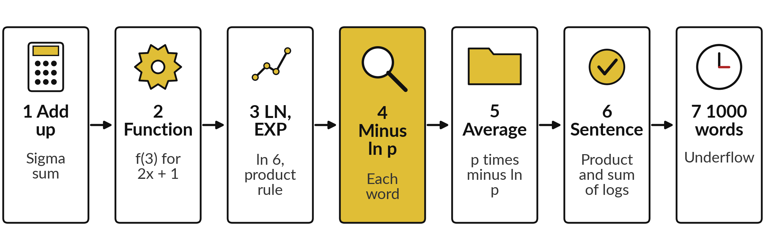
The lab has seven steps, and each
one uses a number from the slides
Predict first, run, read, then change one thing. Steps 6 and 7 are the sentence of six words, then the 1000-word test.
Notes:
Here is the map of the lab. Step one, the sigma sum of the five probabilities. Step two, the function f of three. Step three, the natural log and the product rule. Step four, minus ln p for each candidate word. Step five, the average of minus ln p, weighted by each probability.
Step six, a six-word sentence, once as a product and once as a sum of logs, with its average per word. Step seven tests a thousand words. In every step, predict first, then run, then read the output, then change one thing. Please do not skip the predictions.

Slide 23







Check your numbers before you move on
What you compute | You should get
Sum of the five probabilities | 1.00
f(3) for f(x) = 2x + 1 | 7
ln 6, and ln 2 + ln 3 | 1.7918
Minus ln p for Kampala (p = 0.62) | 0.478
Sum of p times minus ln p, five words | 1.133
Six word p: product, then sum of ln | 0.005208 and −5.2576
Average minus ln p per word, sentence | 0.8763
1000 words, p = 0.2: sum of logs | −1609.44
If your number differs, find the step that went wrong. Do not change a number to match.
Notes:
Use this table as your checkpoint. If your numbers match, carry on. If one does not, stop and call me, because later steps use the earlier ones. The most common cause is a cell run out of order, or a minus sign missing in front of the logarithm.
Do not change a number to make it match. Find out why it is different. The Check sheet in the workbook and the last cell of the notebook do the same comparison for you.

Slide 24




Four messages you may meet,
what they mean and what to do
What you see | What it means | What to do
nan or a RuntimeWarning from np.log, or #NUM! from LN | You took the log of 0 or of a negative number. A logarithm needs a number above 0. | Check the probabilities. None may be 0 or negative.
My log-probability is negative | That is correct. A probability below 1 has a negative natural logarithm. | Use minus ln p when you want a positive number.
The 1000-word product shows 0.0 | Underflow: the true value is about 10⁻⁶⁹⁹, too small to store. | Use the sum of the logs. That is the point of the step.
#NAME? in a spreadsheet | The function name is misspelt, or your region uses a semicolon between the arguments. | Retype the function. Try ; instead of ,
Notes:
Four messages you may meet. A nan, a warning, or the error hash NUM means you took the log of zero or of a negative number, so check the probabilities. A negative log-probability is correct, because a probability below one has a negative natural log. A product that shows zero is underflow, which is exactly what step seven is about.
And hash NAME in a spreadsheet usually means a misspelt function, or a region that wants a semicolon. Read the message first. It usually tells you the answer.

Slide 25
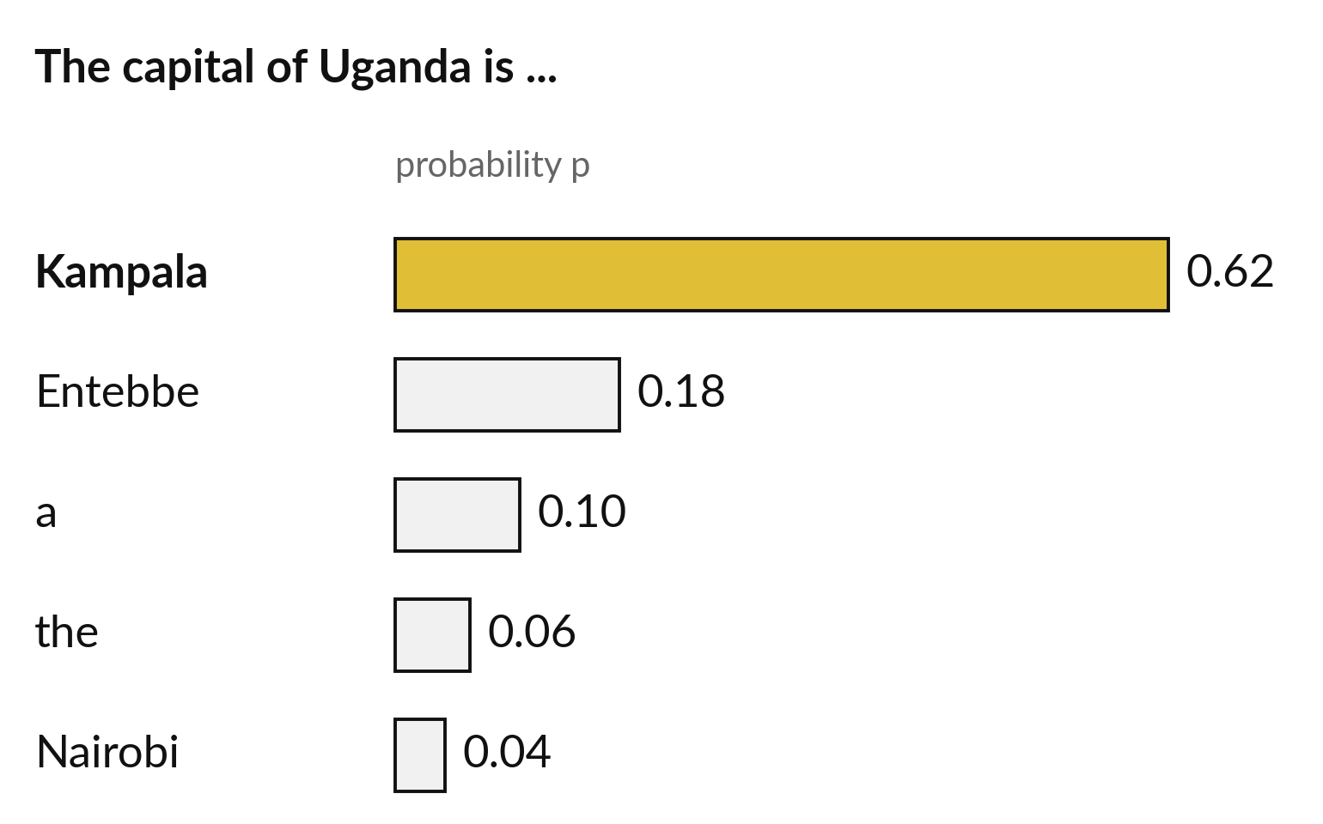
Where this appears in AI: a probability
for every possible next word
Language models of this kind give every possible next token a probability.
A token is a piece of text, often a word or part of a word.
These numbers are illustrative (made up). They add up to 1.
Open models publish vocabularies of 32,000 to over 250,000 tokens.
Notes:
Now to where this appears. ChatGPT, Gemini, Claude and other assistants are products built on large language models. Their exact designs are not published, but published research describes how models of this kind work. They read the text so far and give every possible next token a probability.
A token is a piece of text, often a word or part of a word. Here are five candidate tokens with made-up probabilities that add up to one. Open models publish vocabularies from roughly thirty-two thousand to more than two hundred and fifty thousand tokens, and score all of them at every step.
Which token would the model most likely choose here?

Slide 26
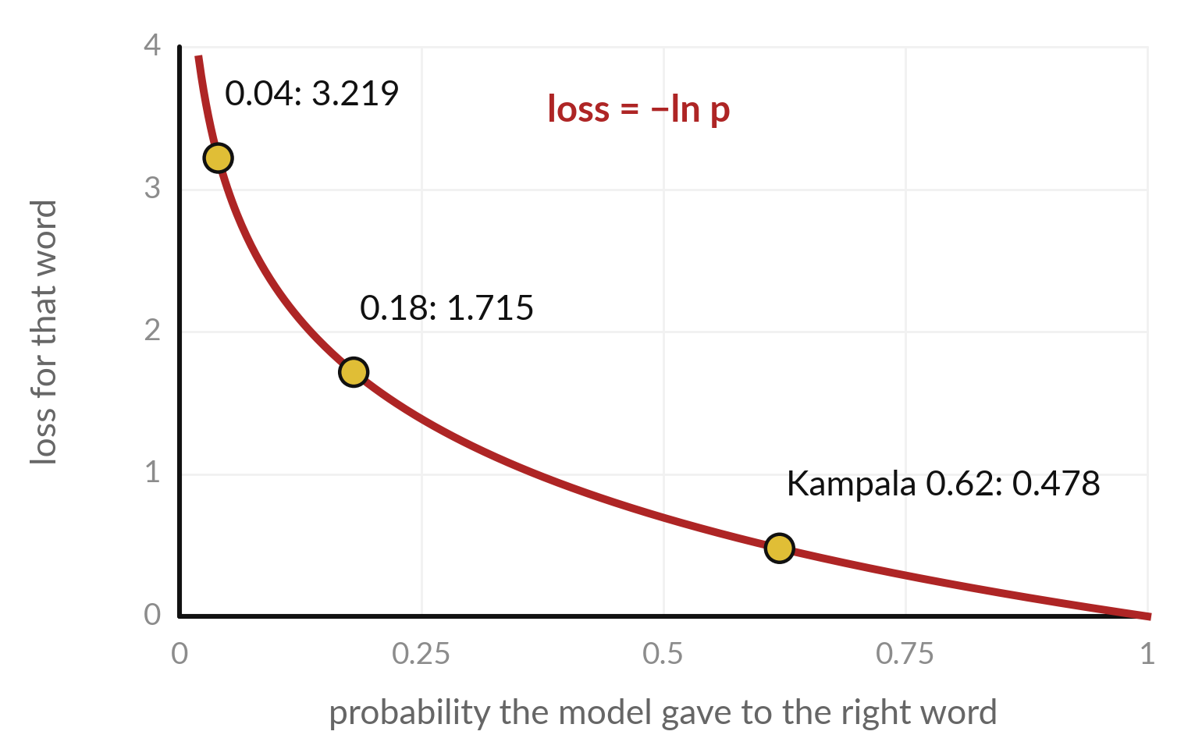
Where this appears in AI: training
uses ln of the right word probability
Training scores the model by minus ln p, where p is the probability it gave the word that really came next.
The right word is Kampala. With p = 0.62 the loss is 0.478.
With only p = 0.04 the loss is 3.219. A low probability on the right word gives a high loss.
The average is the cross-entropy loss (Session 17).
Notes:
Here is the link to training. Published research describes language models of this kind as trained to predict the next token. For each position in a text, the model gives a probability to the token that really came next. The training score for that position is minus ln of that probability, called the loss.
If the model gave Kampala zero point six two, the loss is zero point four seven eight. If it gave only zero point zero four, the loss is three point two one nine. So a low probability on the right word means a high loss, and training pushes the loss down.
The average of these numbers is called the cross-entropy loss, and we meet it properly in Session seventeen. Why does a sum of logs suit a whole text?

Slide 27
Where this appears in AI: check
an assistant with your numbers
8 minutes
Hands-on activity
Ask any AI assistant: "What is ln 6, and what is ln 2 plus ln 3?"
You keep
A note: the assistant answer, your lab number, and whether they agree.
Use only public maths. Never paste confidential data.
Compare its ln 6 with your lab number, 1.7918.
Ask why the two answers agree. Does the reasoning match the product rule?
Ask the same question again. Does the answer change?
Notes:
Now a short activity. Open any AI assistant you like. Ask it: what is ln six, and what is ln two plus ln three. Then compare its answer with the number you computed in the lab, one point seven nine one eight. Ask it to explain why the two agree, and judge for yourself whether its explanation matches the product rule from today.
Then ask the same question a second time. Does the answer stay the same?
Never paste anything confidential into an assistant. These numbers are public maths, so they are safe. Write down what you found. Who trusts the answer, and why?

Slide 28


Exit check: three questions, then
compare with the short answers
Question | Short answer
What is the sum from i = 1 to 3 of p_i, when p_1 = 0.5, p_2 = 0.3 and p_3 = 0.2? | 1.0. Sigma means add: 0.5 + 0.3 + 0.2.
Fill the gap: ln 12 = ln 3 + ln ? | ln 4, because 3 × 4 = 12 and the logarithm of a product is the sum of the logarithms.
Why do AI programs add log-probabilities instead of multiplying probabilities? | A product of many small probabilities underflows to 0. A sum of logs stays an ordinary number.
Notes:
Last, the exit check. Three questions. Write your answers in your notes before you look at mine. One, with p one equal to point five, p two point three and p three point two, what is the sigma sum?
Two, fill the gap: ln twelve equals ln three plus ln what?
Three, why do AI programs add log-probabilities and not multiply probabilities?
The short answers are on the slide. If you got all three, you are ready for vectors next session. If one surprised you, look at that part of the lab again tonight.

Slide 29
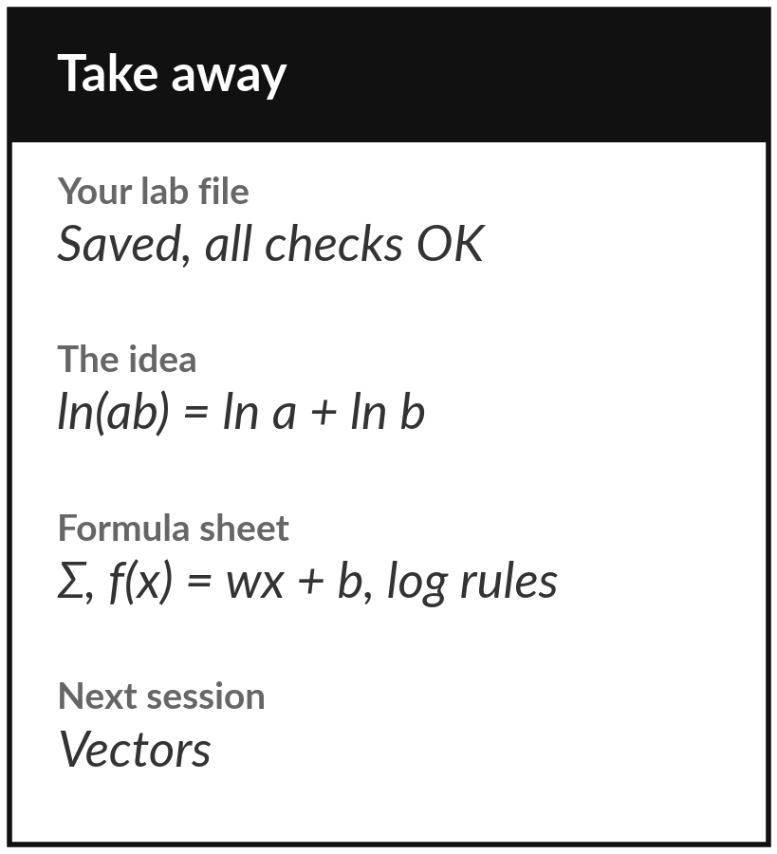
Save your lab file and start your formula sheet
What you keep from today
Keep your saved notebook or workbook, with every check on OK. Keep the one idea of the day: the logarithm of a product is the sum of the logarithms, and that is why AI adds log-probabilities.
Our question today
A language model gives every possible next word a probability. Why does training work with the logarithm of that probability?
Next session
Session 2: Vectors. A row of data becomes a list of numbers that we can add, scale and compare.
Notes:
Before you go, save your notebook or workbook with every check on OK. Start the one-page formula sheet that you will build across the course. Write down three things today: the sigma sum, f of x equals w x plus b, and the three log rules, each with its industry name.
Next session we turn a row of data into a vector and find out how an AI search tool measures how close two pieces of text are. If anything was unclear today, write the question down and bring it.
We began with this question: A language model gives every possible next word a probability. Why does training work with the logarithm of that probability? Before you go, say in one sentence what you can now say about it.

